Slide 1
Switching Techniques: Circuit Switching Message Switching Packet Switching

Slide 2
Introduction
When there are many devices, it is necessary to develop suitable mechanism for communication between any two devices.
One alternative is to establish point-to-point communication between each pair of devices using mesh topology. However, mesh topology is impractical for large number of devices, because the number of links increases exponentially (n(n-1)/2, where n is the number of devices) with the number of devices.
A better alternative is to use switching techniques leading to switched communication network. In the switched network methodology, the network consists of a set of interconnected nodes, among which information is transmitted from source to destination via different routes, which is controlled by the switching mechanism.

Slide 3
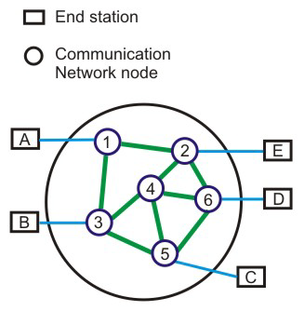
A basic model of a switched communication is shown in Fig. 4 The end devices that wish to communicate with each other are called stations. The switching devices are called nodes. Some nodes connect to other nodes and some are to connected to some stations.
Key features of a switched communication network are given below:
Network Topology is not regular.
Uses FDM or TDM for node-to-node communication.
There exist multiple paths between a source-destination pair for better network reliability.
The switching nodes are not concerned with the contents of data.
Their purpose is to provide a switching facility that will move data from node to node until they reach the destination.

Slide 4
The switching performed by different nodes can be categorized into the following three types:
Circuit Switching
Packet Switching
Message Switching

Slide 5
Circuit switching Technique
Communication via circuit switching implies that there is a dedicated communication path between the two stations. The path is connected through a sequence of links between network nodes. On each physical link, a logical channel is dedicated to the connection. Circuit switching is commonly used technique in telephony, where the caller sends a special message with the address of the callee (i.e. by dialling a number) to state its destination. It involved the following three distinct steps,
Circuit Establishment: To establish an end-to-end connection before any transfer of data.
Some segments of the circuit may be a dedicated link, while some other segments may be shared.
Data transfer:
Transfer data is from the source to the destination.
The data may be analog or digital, depending on the nature of the network.
The connection is generally full-duplex.
Circuit disconnect:
Terminate connection at the end of data transfer.
Signals must be propagated to deallocate the dedicated resources. A

Slide 6
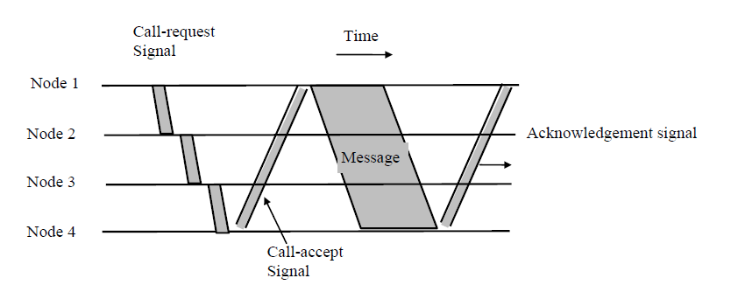
Circuit switching Technique

Slide 7
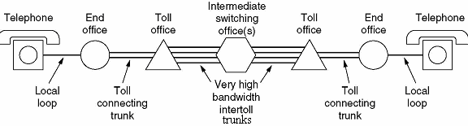

Slide 8
Disadvantages:
Provide initial delay for setting up the call.
Inefficient for bursty traffic.
Data rate should be same because of fixed bandwidth.
When load increases, some calls may be blocked.
In data communication, traffic between terminal and server are not continuous. Sometimes more data may come or sometimes there is no data at all. Circuit switching is not efficient because of its fixed bandwidth.
Advantages:
After path is established, data communication without delay.
Very suitable for continuous traffic.
It establishes a dedicated path.
No overhead after call setup.
it is transparent and data passes in order.

Slide 9
In circuit switching, network resources are dedicated to a particular connection. Although this satisfies the requirement of voice communication, it suffers from the following two shortcomings for data communication:
In a typical user/host data connection, line utilization is very low.
Provides facility for data transmission at a constant rate.
However, for information transmission applications, the circuit switching method is very slow, relatively expensive and inefficient.
First of all, the need to establish a dedicated connection before sending the message itself inserts a delay time, which might become significant for the total message transfer time. Moreover, the total channel remains idle and unavailable to the other users once a connection is made. On the other hand once a connection is established, it is guaranteed and orderly delivery of message is ensured. Unfortunately, the data transmission pattern may not ensure this, because data transmission is bursty in nature. As a consequence, it limits the utility of the method.

Slide 10
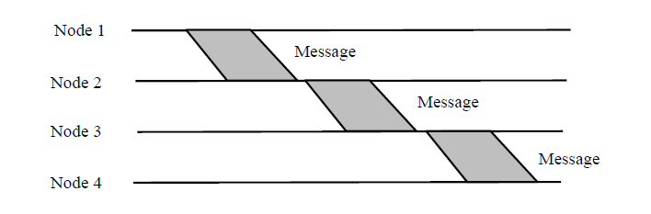
Message Switching
The problem may be overcome by using an approach known as message switching. Message switching suffers from various problems ,To overcome the limitations of message switching, another switching technique, known as packet switching was invented.
In this switching method, a different strategy is used, where instead of establishing a dedicated physical line between the sender and the receiver, the message is sent to the nearest directly connected switching node. This node stores the message, checks for errors, selects the best available route and forwards the message to the next intermediate
The line becomes free again for other messages, while the process is being continued in some other nodes. Due to the mode of action, this method is also known as store-and-forward technology where the message hops from node to node to its final destination. Each node stores the full message, checks for errors and forwards it.

Slide 11
In this switching technique, more devices can share the network bandwidth, as compared with circuit switching technique.
Temporary storage of message reduces traffic congestion to some extent. Higher priority can be given to urgent messages, so that the low priority messages are delayed while the urgent ones are forwarded faster. Through broadcast addresses one message can be sent to several users.
Last of all, since the destination host need not be active when the message is sent, message switching techniques improve global communications.
However, since the message blocks may be quite large in size, considerable amount of storage space is required at each node to buffer the messages. A message might occupy the buffers for minutes, thus blocking the internodal traffic.
Basic idea:
Each network node receives and stores the message
Determines the next leg of the route, and
Queues the message to go out on that link.
Advantages:
Line efficiency is greater (sharing of links).
Data rate conversion is possible.
Even under heavy traffic, packets are accepted, possibly with a greater delay in delivery.
Message priorities can be used, to satisfy the requirements, if any.
Disadvantages: Message of large size monopolizes the link and storage

Slide 12
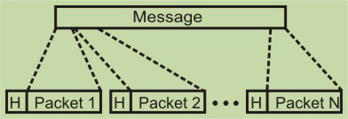
Packet Switching
The basic approach is not much different from message switching. It is also based on the same ‘store-and-forward’ approach. However, to overcome the limitations of message switching, messages are divided into subsets of equal length called packets. This approach was developed for long-distance data communication (1970) and it has evolved over time. In packet switching approach, data are transmitted in short packets (few Kbytes). A long message is broken up into a series of packets as shown in Fig. Every packet contains some control information in its header, which is required for routing and other purposes.

Slide 13
Main difference between Packet switching and Circuit Switching is that the communication lines are not dedicated to passing messages from the source to the destination. In Packet Switching, different messages (and even different packets) can pass through different routes, and when there is a "dead time" in the communication between the source and the destination, the lines can be used by other sources.
There are two basic approaches commonly used to packet Switching: virtual-circuit packet switching and datagram packet switching. In virtual-circuit packet switching a virtual circuit is made before actual data is transmitted, but it is different from circuit switching in a sense that in circuit switching the call accept signal comes only from the final destination to the source while in case of virtual-packet switching this call accept signal is transmitted between each adjacent intermediate node

Slide 14
Virtual Circuit Packet Switching Networks
An initial setup phase is used to set up a route between the intermediate nodes for all the packets passed during the session between the two end nodes. In each intermediate node, an entry is registered in a table to indicate the route for the connection that has been set up. Thus, packets passed through this route, can have short headers, containing only a virtual circuit identifier (VCI), and not their destination. Each intermediate node passes the packets according to the information that was stored in it, in the setup phase. In this way, packets arrive at the destination in the correct sequence, and it is guaranteed that essentially there will not be errors.
This approach is slower than Circuit Switching, since different virtual circuits may compete over the same resources, and an initial setup phase is needed to initiate the circuit. As in Circuit Switching, if an intermediate node fails, all virtual circuits that pass through it are lost. The most common forms of Virtual Circuit networks are X.25 and Frame Relay, which are commonly used for public data networks (PDN).

Slide 15
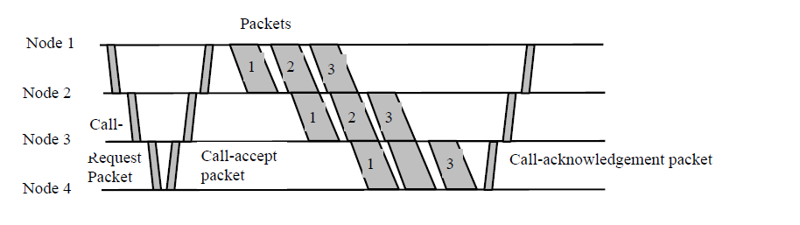

Slide 16
Datagram Packet Switching Networks
This approach uses a different, more dynamic scheme, to determine the route through the network links. Each packet is treated as an independent entity, and its header contains full information about the destination of the packet. The intermediate nodes examine the header of the packet, and decide to which node to send the packet so that it will reach its destination. In the decision two factors are taken into account:
The shortest ways to pass the packet to its destination - protocols such as RIP/OSPF are used to determine the shortest path to the destination.
Finding a free node to pass the packet to - in this way, bottlenecks are eliminated, since packets can reach the destination in alternate routes.
Thus, in this method, the packets don't follow a pre-established route, and the intermediate nodes (the routers) don't have pre-defined knowledge of the routes that the packets should be passed through.

Slide 17
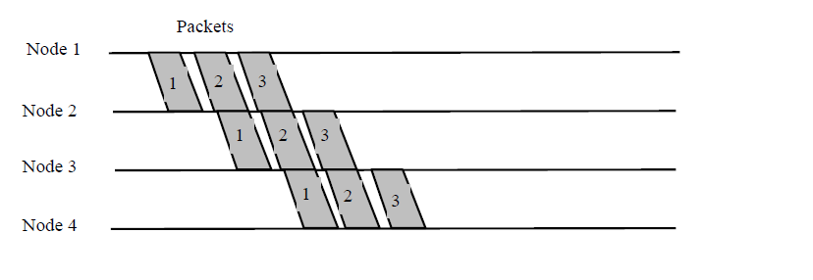
Packets can follow different routes to the destination, and delivery is not guaranteed (although packets usually do follow the same route, and are reliably sent). Due to the nature of this method, the packets can reach the destination in a different order than they were sent, thus they must be sorted at the destination to form the original message. This approach is time consuming since every router has to decide where to send each packet. The main implementation of Datagram Switching network is the Internet, which uses the IP network protocol.

Slide 18
Advantages:
Call setup phase is avoided (for transmission of a few packets, datagram will be faster).
Because it is more primitive, it is more flexible.
Congestion/failed link can be avoided (more reliable).
Problems:
Packets may be delivered out of order.
If a node crashes momentarily, all of its queued packets are lost.

Slide 19
In spite of increase in overhead, the transmission time may decreases in packet switching technique because of parallelism in transmission

Slide 20
Virtual Circuit Versus Datagram Packet Switching
Key features of the virtual circuit packet switching approach is as follows:
Node need not decide route
More difficult to adopt to congestion
Maintains sequence order
All packets are sent through the same predetermined route
On the other hand, the key features of the datagram packet switching are as follows:
Each packet is treated independently
Call set up phase is avoided
Inherently more flexible and reliable

Slide 21
